Slide 1
FEM V1 of mAEWing1
Rakesh K. Kapania
Mitchell Professor of Aerospace and Ocean Engineering
Wei Zhao
Rikin Gupta
Neeharika Muthirevula
April 2, 2015
Multidisciplinary Analysis and Design Center for Advanced Vehicles Virginia Polytechnic Institute and State University Blacksburg, VA 24061-0203

Slide 2
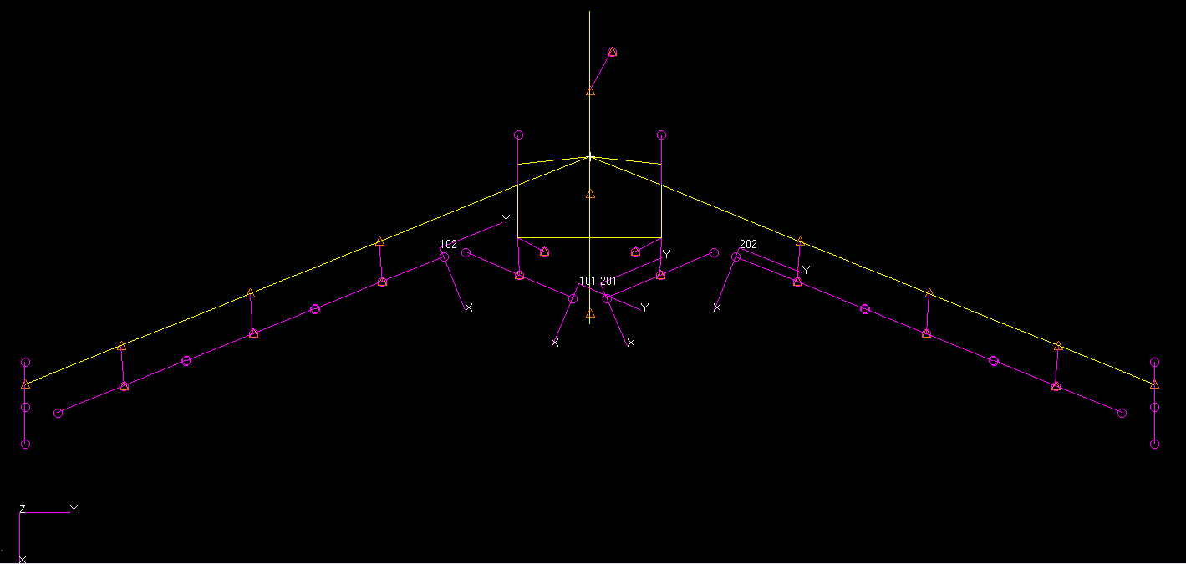
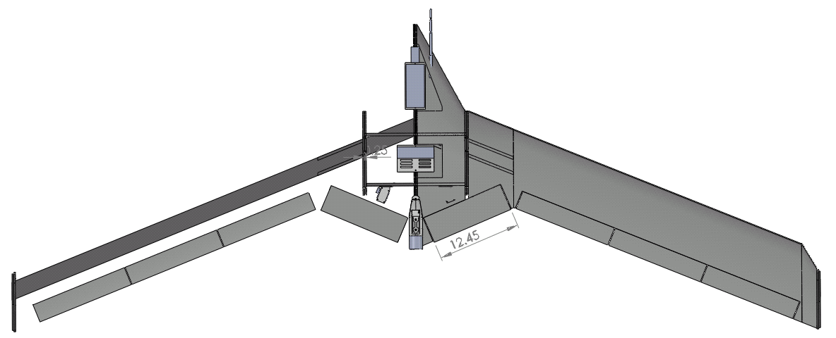
NASTRAN mAEWing1 FEM V1
mAEWing1
NASTRAN
Beam-rod FEM v1.0
CAD model of mAEWing1 provided by UMN

Slide 3
Main data
 | EI (lb-in^2) | E (psi) | Ixx(out-of-plane) (in^4) | Izz(in-plane) | GJ (lb-in^2) | G (psi)
Predicted Spar Properties | 3.3948E+04 (97.43 N-m^2) | 6.6601E+06 (45.92GPa) | 5.097E-3 ( 2.12E-9 m^4) | Assume 300 Ixx | 2.0603E+04 ( 59.13 N-m^2) | 1.2518E+06 (8.63 GPa)
 | J (in^4) | Cross sectional Area (in^2) | Density (lb/in^3) (AIAA-2015-0903)
 | 1.646E-2 (increased for foam GJ) (6.85E-9 m^4) | BFF’s 3’’*0.256’’ | 0.045223 (1251.8kg/m^3)
 | Density, lb/in^3
XPS | 0.0015
Component | Actuators (Futaba S9254 ) | Flight computer | Batteries | Engine motor | Winglet | Servos
Weight | 0.126 lb | 0.513lb | 0.50 lb | 0.441 lb | 0.1102 lb with 2.7’’ offset to EA | 0.02205 lb
CG locations of these components are calculated in SolidWorks, they could not match with real data

Slide 4
Summary of mAEWing1 FEM v1
Mass properties
Property | mAEWing1 | BFF
Total weight, lb | 12.022 | 11.99
C.G. location (From nose), inches | 24.958 | 23.29
Pitching moment of inertia, Iyy, lb-in^2 | 1132.46 | 1245.83
Rolling moment of inertia, Ixx, lb-in^2 | 9595.70 | 8529.45
Mode frequencies
mAEWing1 Modes | mAEWing1 (Hz) | BFF (Hz)
6 Rigid modes | 0.00 | 0.00
1st Sym bending mode | 5.494 | 5.67
1st A/S bending mode | 8.568 | 8.37
1st A/S torsion mode* | 17.813 | 18.44 (ST)
1st Sym torsion mode | 18.529 | 19.82(AST)
2nd Sym bending mode | 21.533 | 23.17
2nd A/S bending mode | 29.305 | 28.60
*Lower frequency for 1st AS torsion mode for mAEWing1 FEM v1

Slide 5
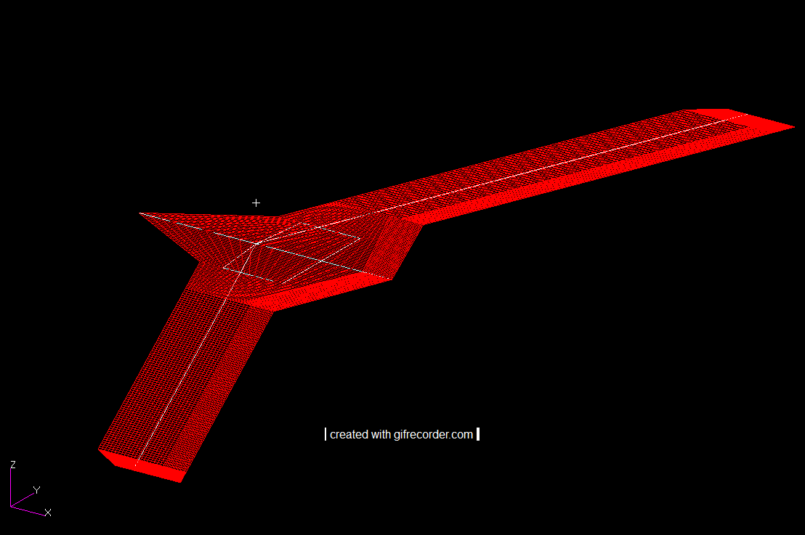
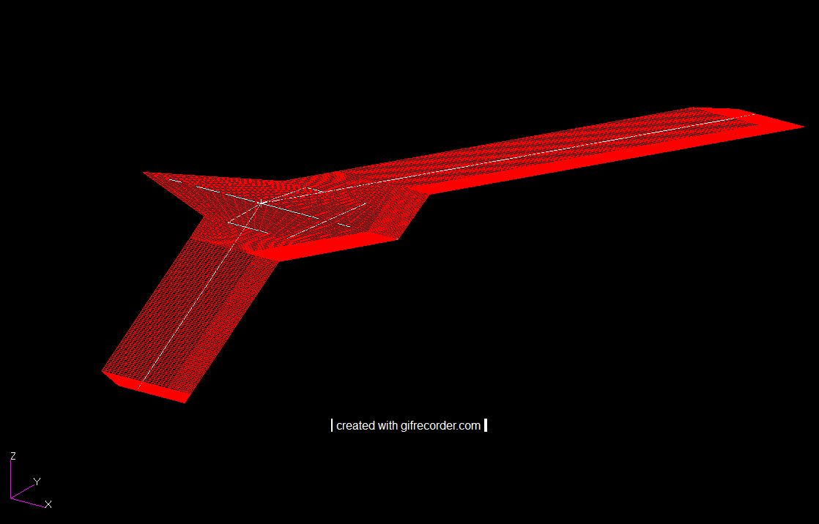
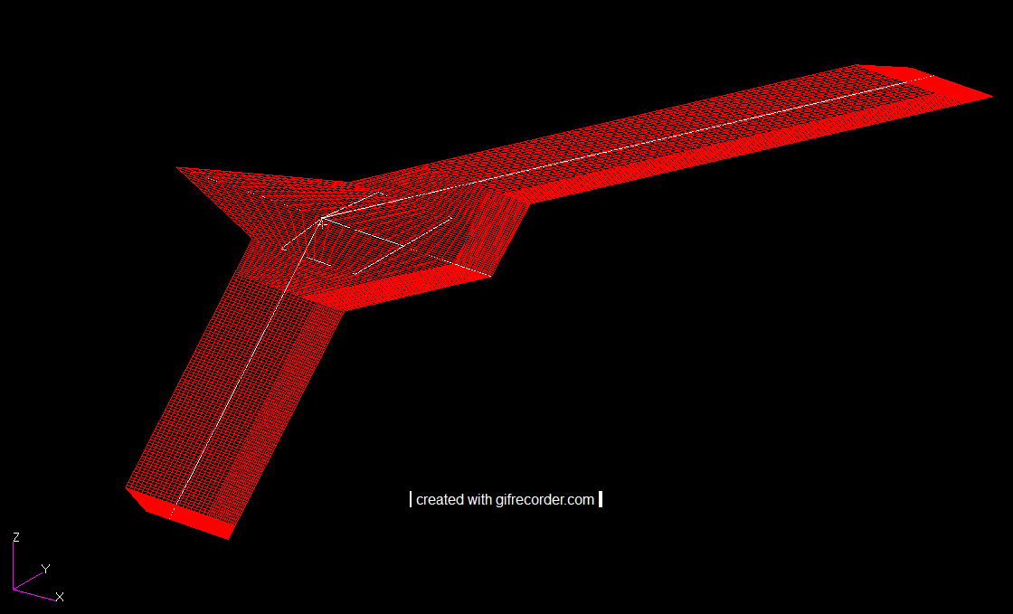
Rigid plunge mode
Rigid plunge mode
Rigid Roll mode
6 Rigid modes obtained from NASTRAN are orthogonal and normalized to system mass matrix
It looks like NASTRAN only spline rigid DOFs including plunge mode, roll mode and pitch mode to the aerodynamic panels
Rigid pitch mode

Slide 6
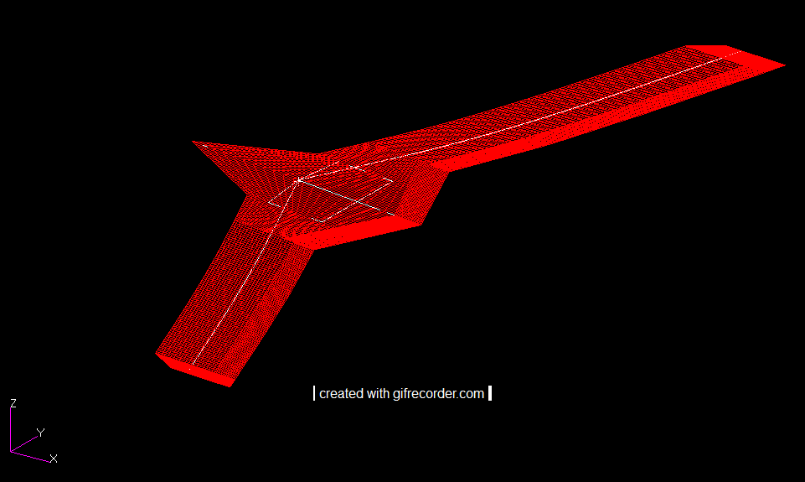
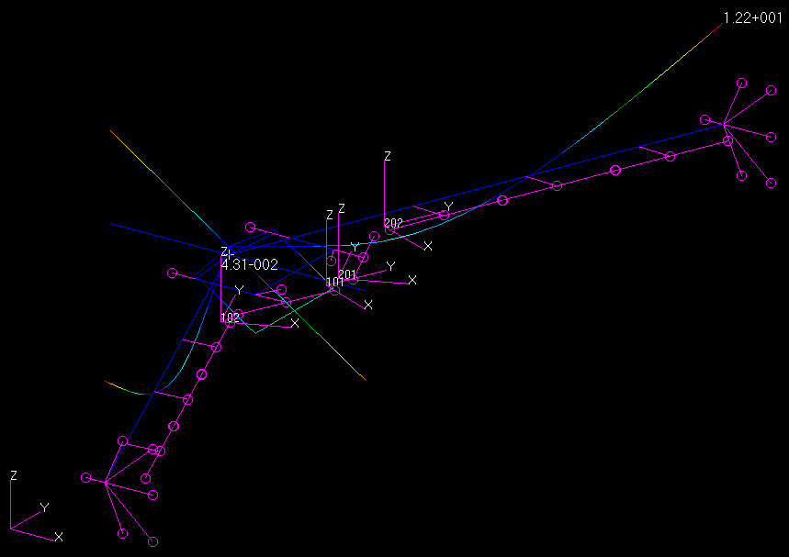
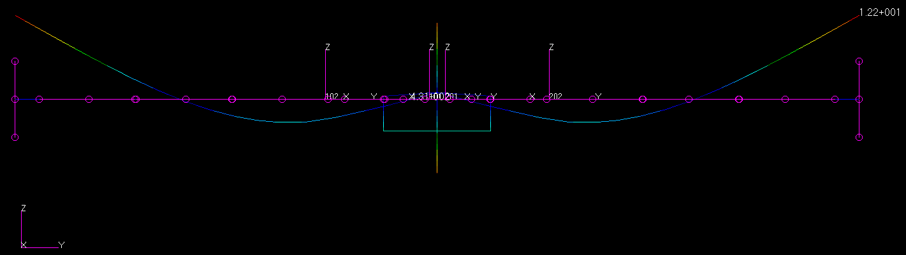
1st Sym Bending Mode
1st Symmetric Bending (SB)
5.494 Hz
(BFF: SB& 5.67 Hz)

Slide 7
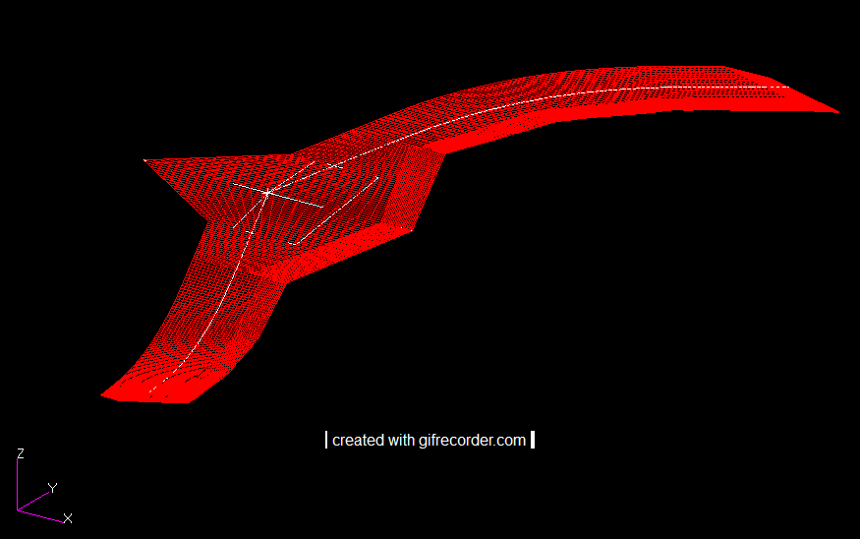
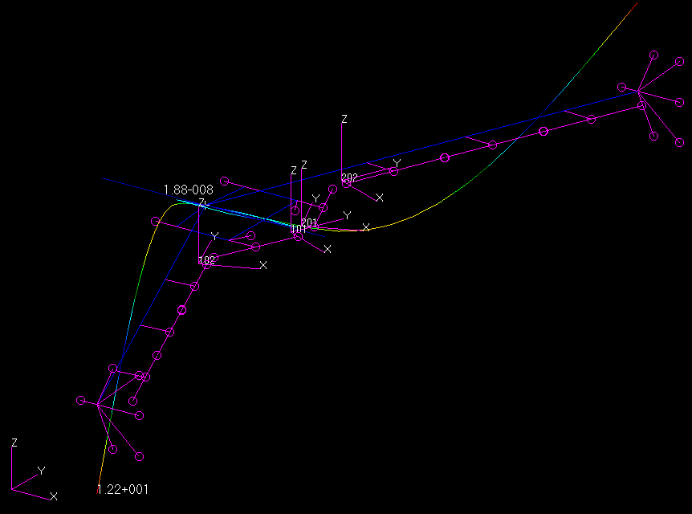
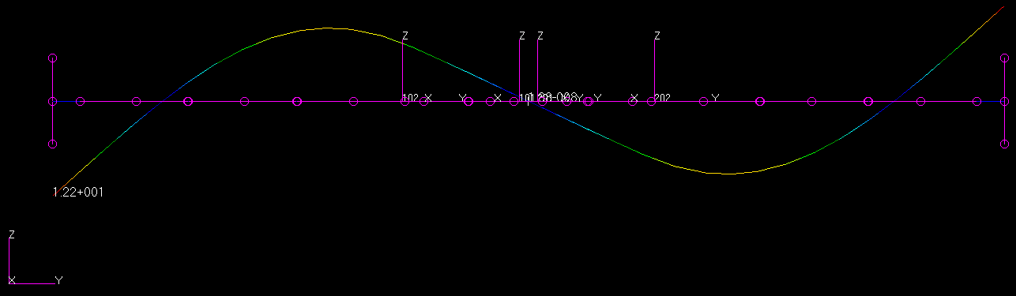
1ST AS Bending Mode
1st Anti-Symmetric Bending (ASB)
8.568Hz
(BFF: ASB& 8.37 Hz)

Slide 8
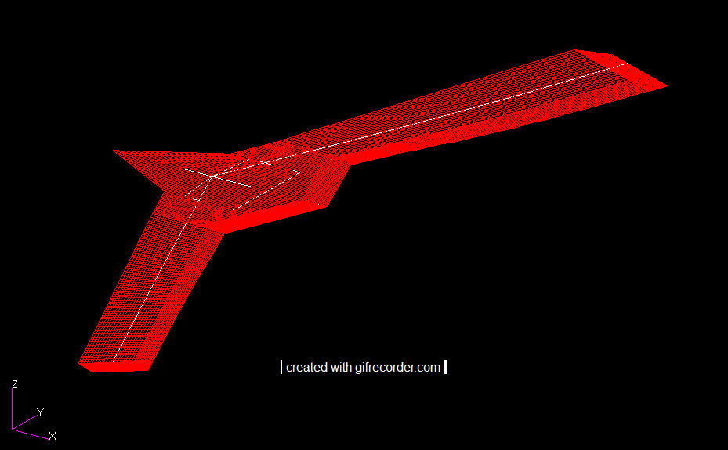
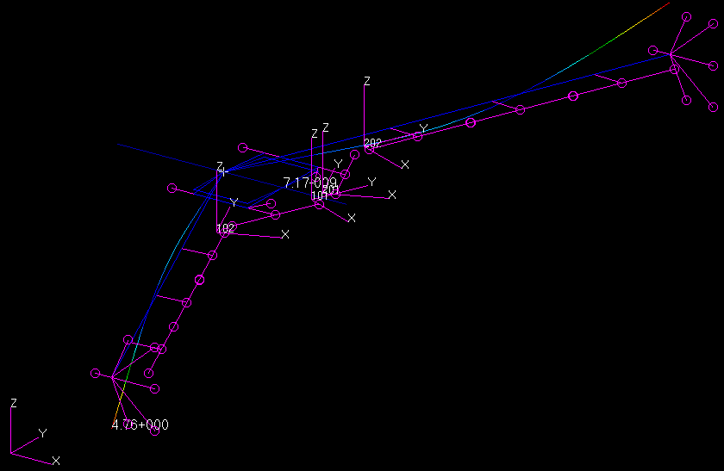
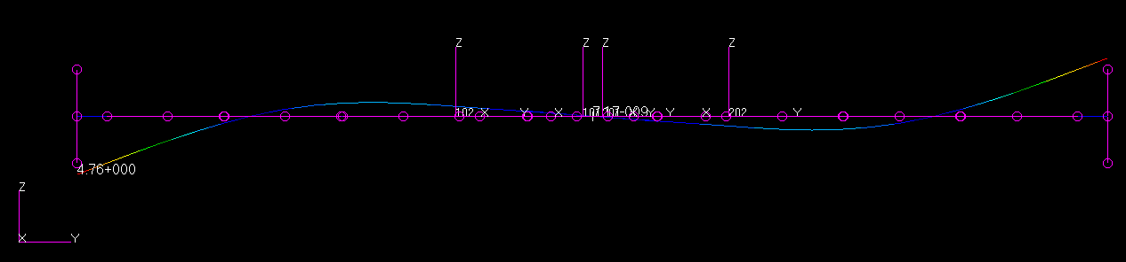
1ST AS Torsion Mode
1st Anti-Symmetric torsion (AST)
17.81 Hz
(BFF: ST& 18.44 Hz)

Slide 9
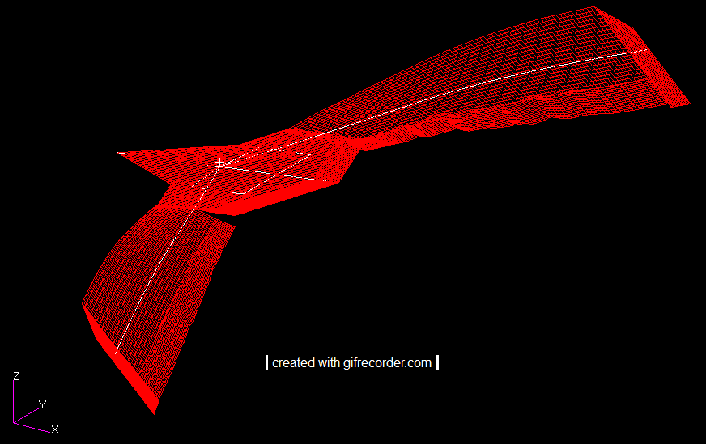
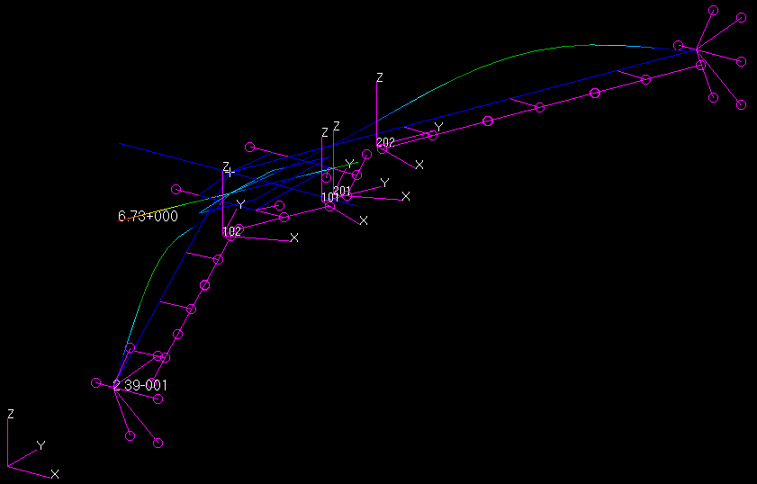
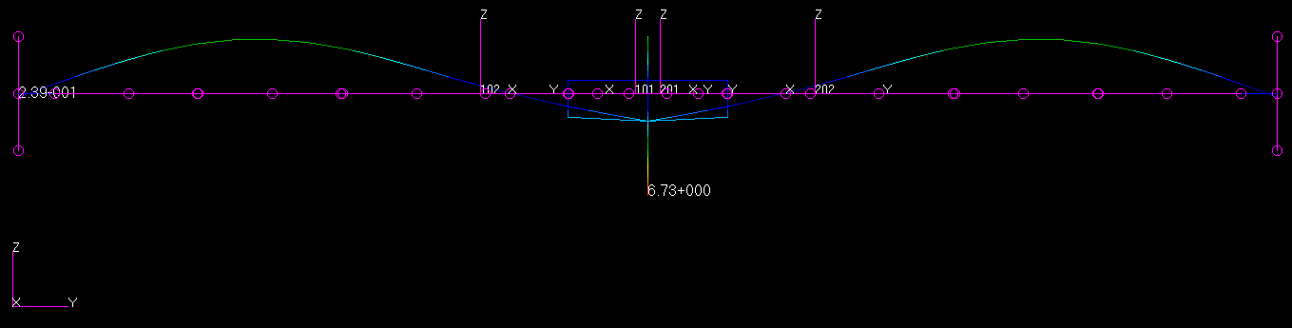
1st SM Torsion Mode
1st Symmetric Torsion (ST)
18.53 Hz
(BFF: AST & 19.82 Hz)

Slide 10
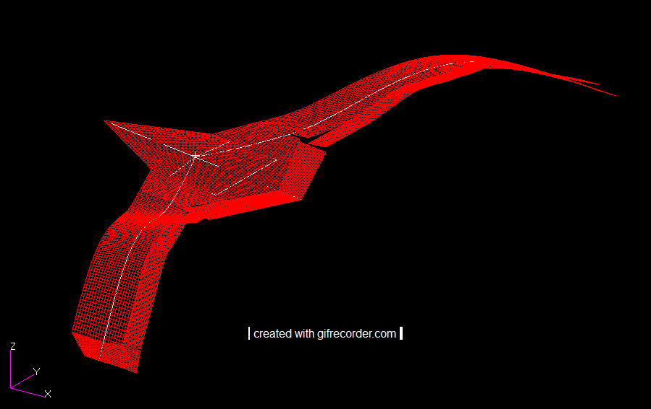
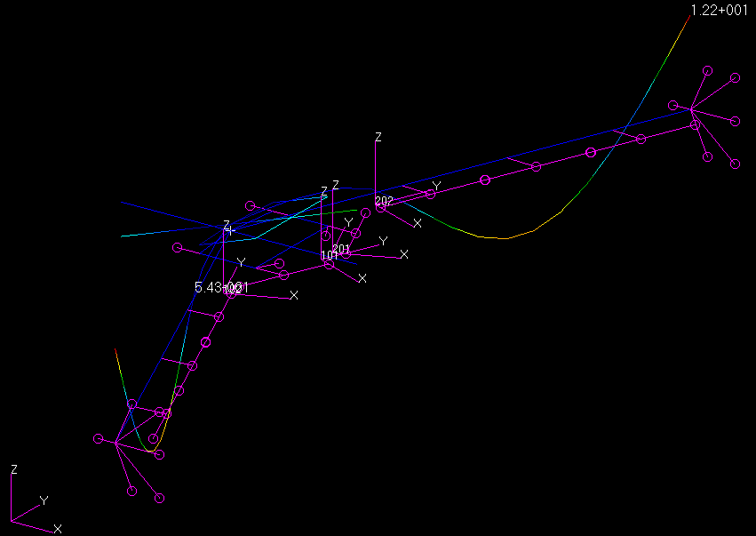
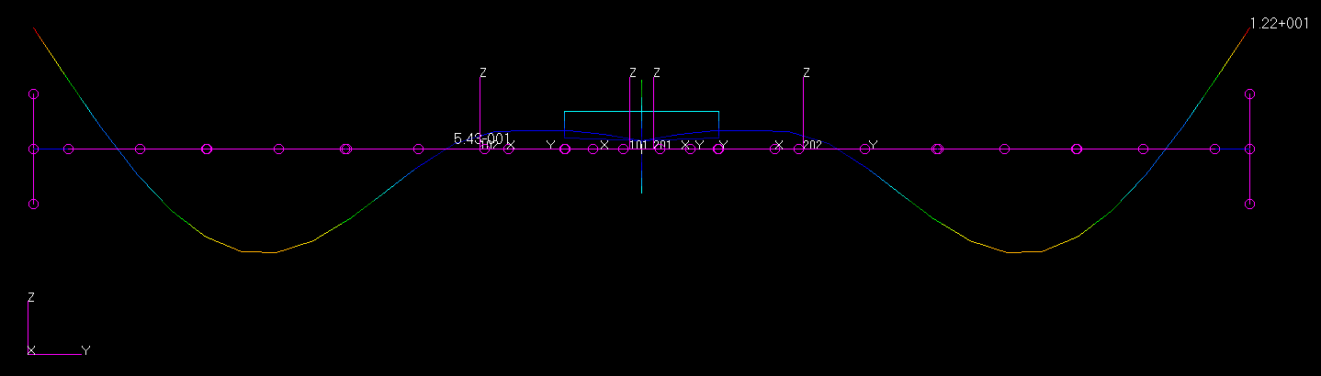
2nd SM Bending Mode
2nd Symmetric Bending (SB)
21.53 Hz
(BFF: SB& 23.17 Hz)

Slide 11
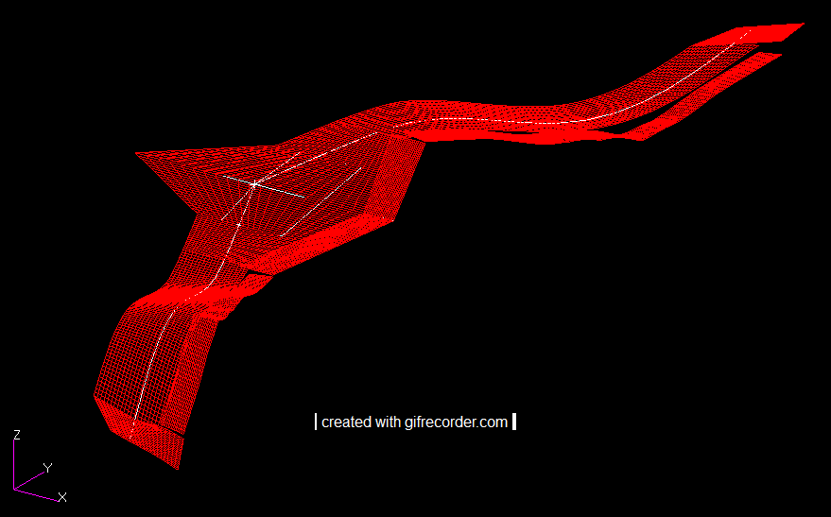
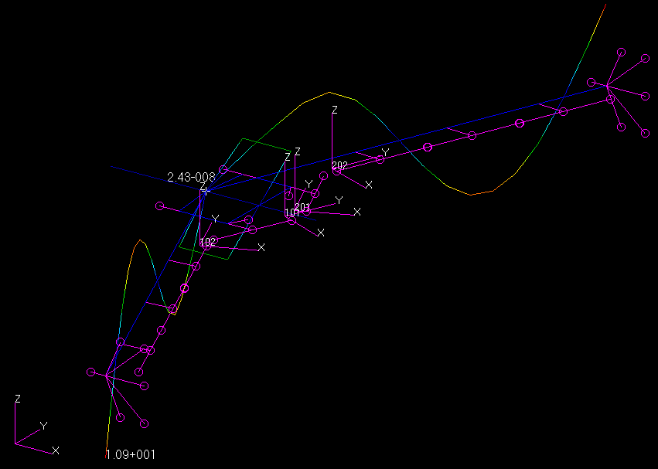
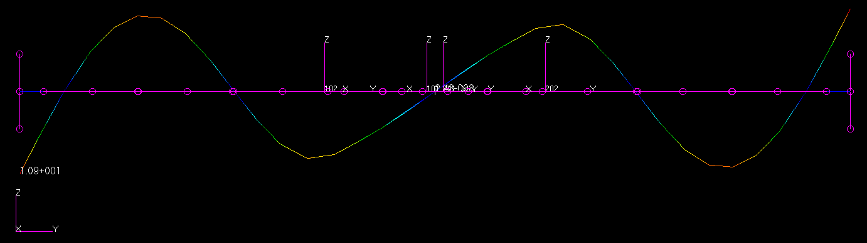
2nd ASM Bending Mode
2nd Anti-Symmetric Bending (ASB) 29.30 Hz
(BFF: ASB& 28.60 Hz)

Slide 12
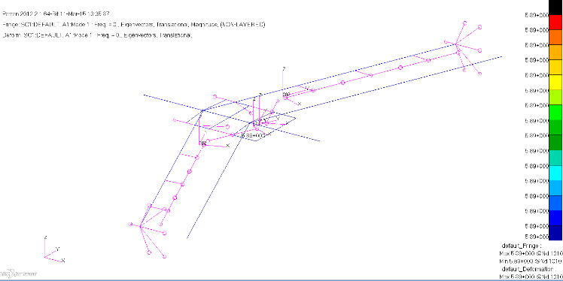
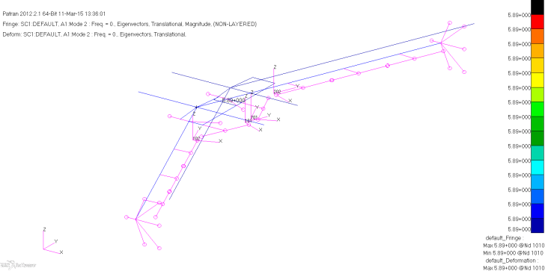
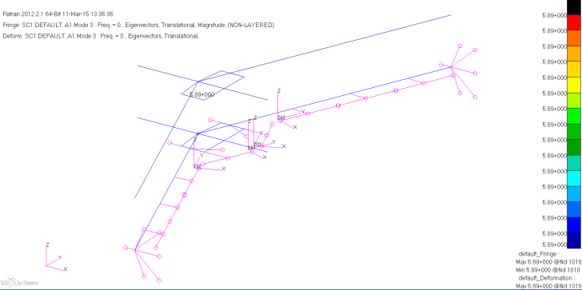
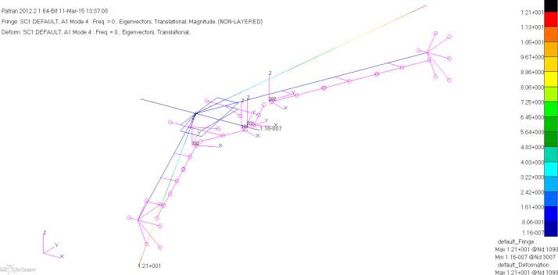

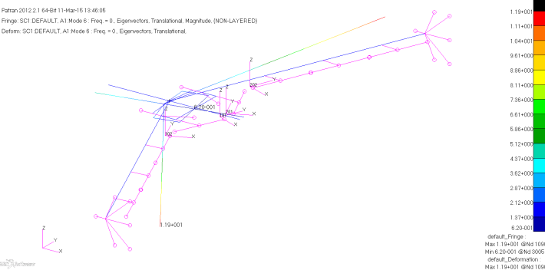
6 Rigid modes
Mode 1
Rigid translational motion along x-axis
Mode 2
Rigid translational motion along y-axis
Mode 3
Plunge mode
Mode 4
Roll
Mode 5
Pitch
Mode 6
Yaw

Slide 13
Summary
Mimic CAD model of mAEWing1 for FEM, current FEM version represents the accurate locations of wing components except those in the fuselage.
Beam properties and materials are obtained based on spar build and test report; point mass distribution are obtained and assumed based on BFF report, AIAA paper 2015-0903
Some values are assumed for beam properties for stiffened members and foam torsional stiffness
mAEWing FEM V1 is subjected to update based on GVT data

